Slide 1
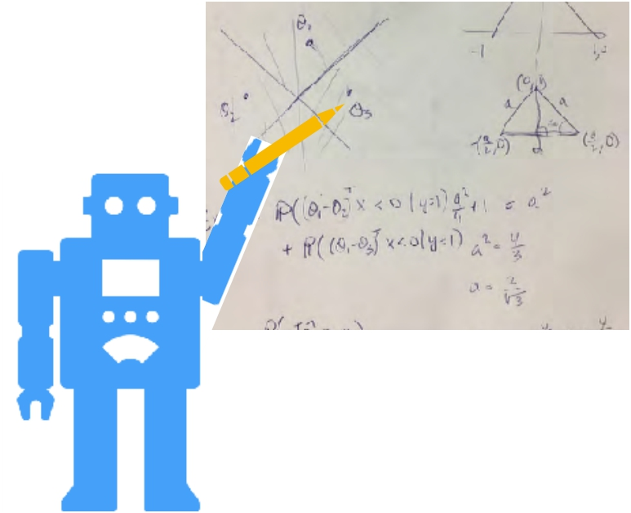
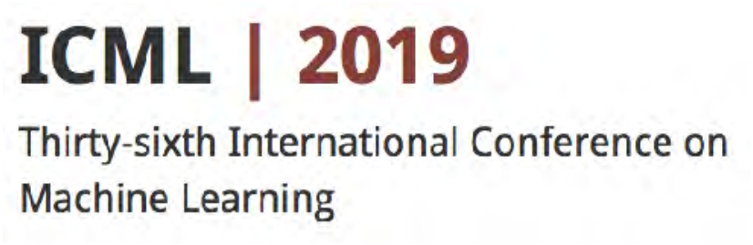
Active Learning from Theory to Practice
Steve Hanneke Toyota Technological Institute at Chicago
steve.hanneke@gmail.com
Robert Nowak UW-Madison rdnowak@wisc.edu

Slide 2
Tutorial Outline
Part 1：Introduction to Active Learning Part 2：Theory of Active Learning
Part 3：Advanced Topics and Open Problems
slides: http://nowak.ece.wisc.edu/ActiveML.html
Notes:
Part 4 : ongoing work in the area of nonparametric active learning.

Slide 3

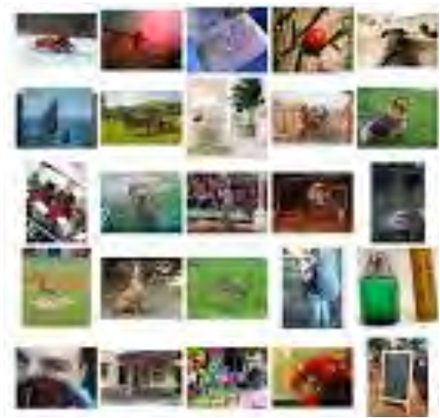
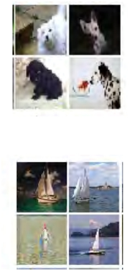
labeled
Conventional (Passive) Machine Learning
unlabeled
raw data
human
labeling
data
dog
boat
machine
learning
predictive
model
…
Notes:
一堆沒有標誌的資料需要專家去標誌再拿去訓練，往往沒有標誌的資料比有標誌的資料多很多

Slide 4
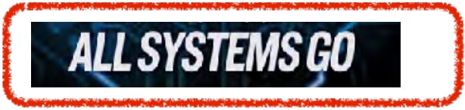
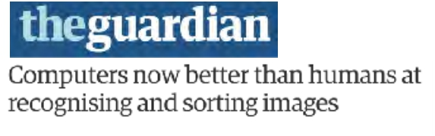
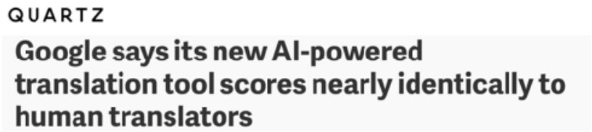
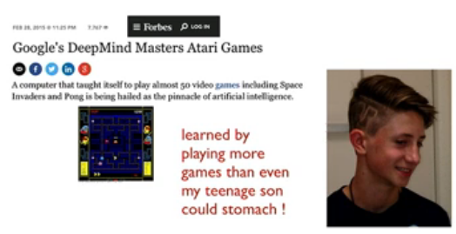
?
millions of labeled images 1000’s of human hours
trained on more texts than a human could read in a lifetime
Notes:
機器其實不像人一樣那樣學習，所用的 Data 都超過人畢生所能得

Slide 5


?
millions of labeled images 1000’s of human hours
trained on more texts than a human could read in a lifetime
Can we train machines with less labeled
data and less human supervision?
Notes:
Trying to figure out how we can train machines with less labels data and less human supervision.

Slide 6
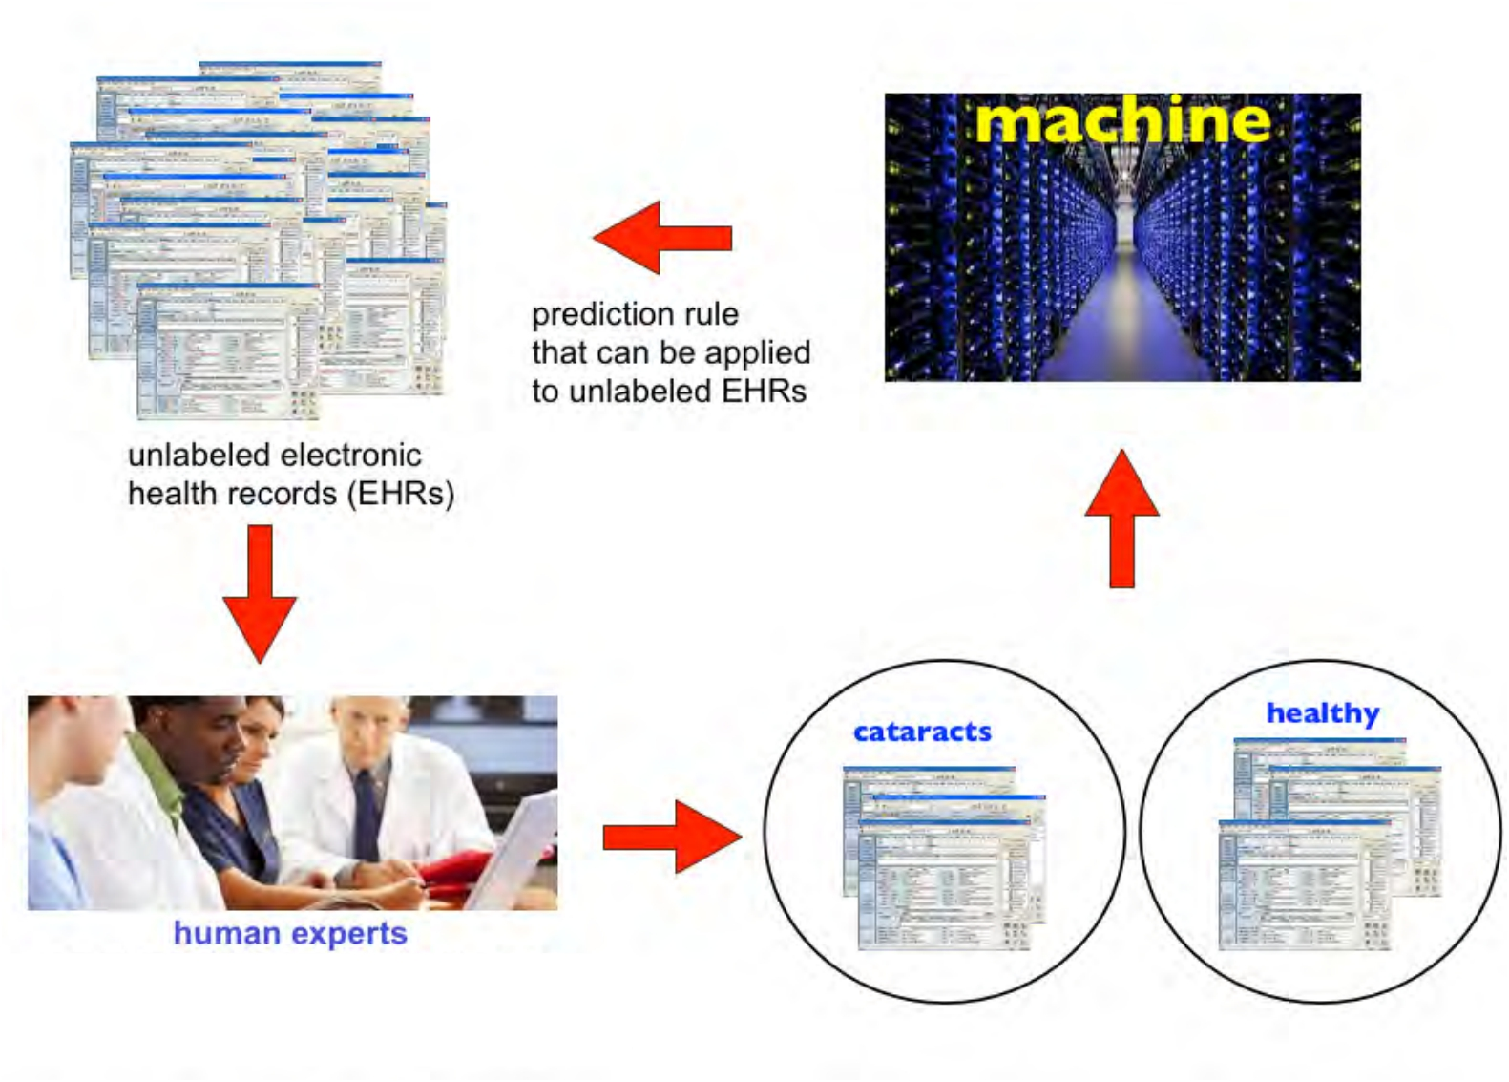
(sevprovides labels to machine learner eral minutes / EHR)
Motivating Appication
Notes:
Human experts here get paid 100 or 200 bucks an hour so these labels are expensive.

Slide 7
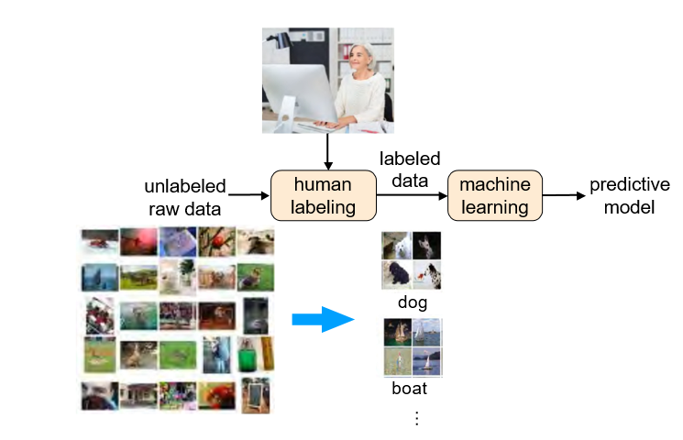
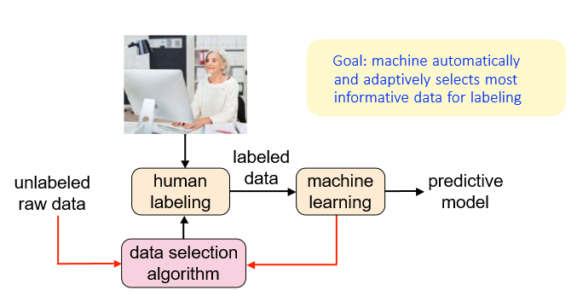
Conventional Machine Learning
(Passive)
Active Machine Learning
Notes:
< Active learning >
This picture is the modified pipeline of conventional ML and show how active machine learning work.
The idea is rather than just taking the random subset of the unlabeled data and asking our human expert to label it instead we’re going to design an extra algorithm. This data selection algorithm is going to be looking at all the unlabeled data and judiciously selecting specific examples and asking human expert to label those.
BASIC IDEA: machine starting to build up a model of how to predict it will flag confusing or cases /example that is uncertain about and ask human expert for help on those specific cases.

Slide 8
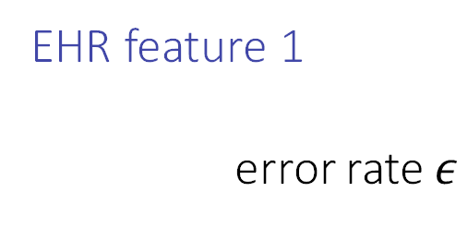
Active Learning
Non-adaptive strategy: Label a random sample
Active strategy: Label a sample near best decision boundary based on labels seen so far
best linear classifier
EHR feature 2
EHR feature 1
error rate $ε$
active learning finds optimal classifier with much less human supervision!
# labels
Notes:
傳統的ML只會在灰點中random取出一個sample來問expert這筆data是否會有疾病。
但active learning中，machine會自己決定哪一個example它比較不確定，並將不確定的sample拿去給expert標記label。

Slide 9
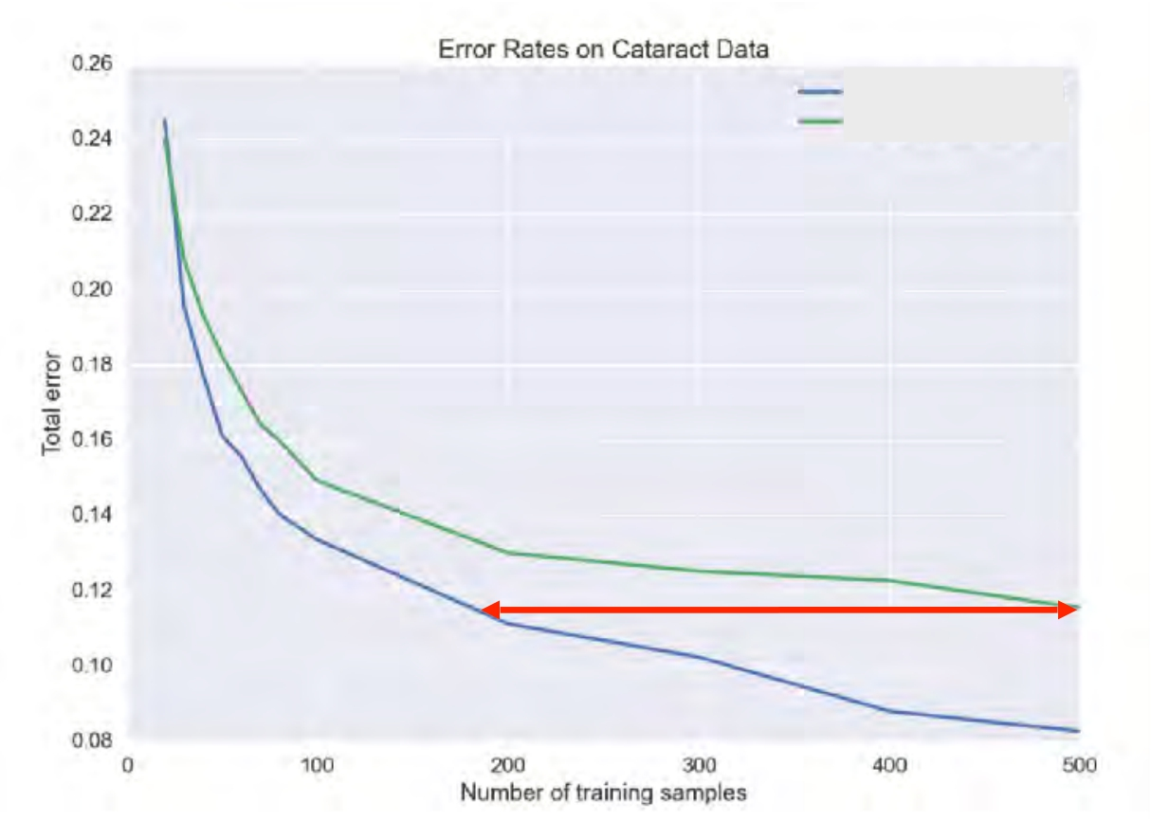
Active Logistic Regression
active learning passive learning
11000 patient records
8000 positive 3000 negative
6182 Numerical Features
icd9 codes lab tests patient data
Classification task: cataracts or healthy
less than half as many labeled
examples needed by active learning

Slide 10

Principles of Active Learning
Notes:
以下是active learning的一些基本原則 (high-level)

Slide 11
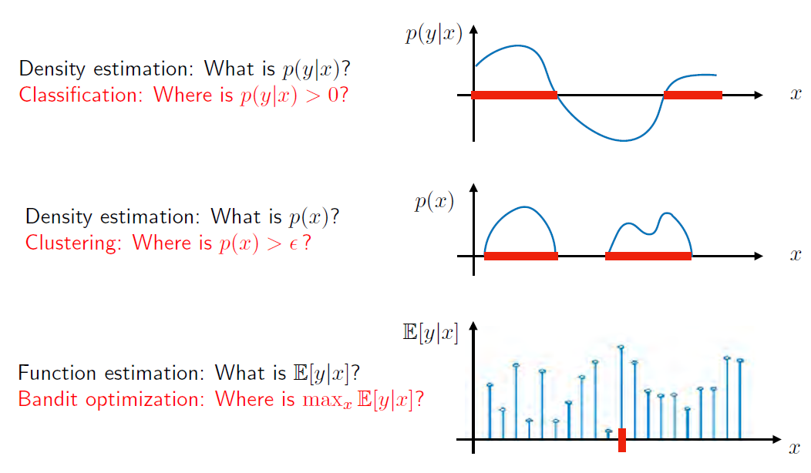
What and Where Information
Active learning is more efficient than passive learning for localized “where” information
Notes:
The most effective places for active learning is situations where you want to learn about where information you want to localize something a decision boundary a maximum of a function the support of a function.
不管是分類、分群、Bandit問題都有active learning 的版本，以下投影片為簡化說明，皆以二元分類為例

Slide 12
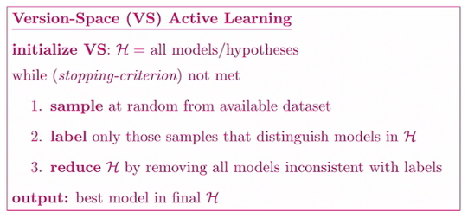
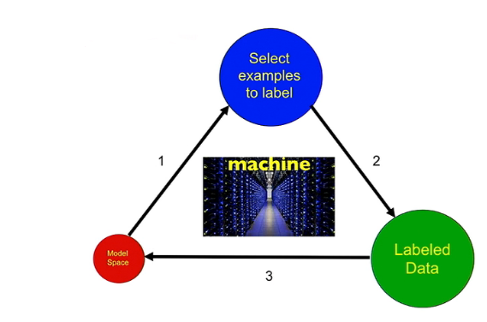
Meta-Algorithm for Active Learning

Slide 13
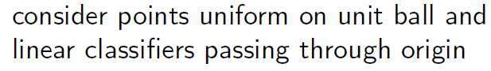
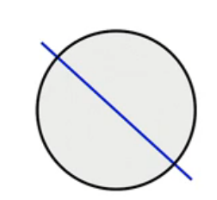
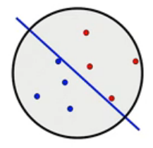
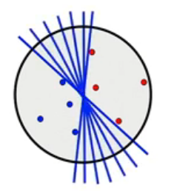
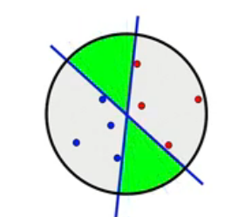
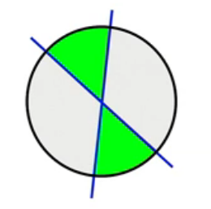
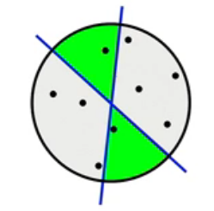
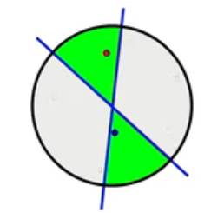
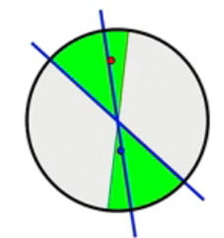
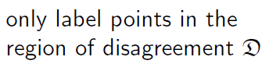
Disagreement-Based Active Learning
Region of disagreement
Machine will go and look at a large set of unlabeled examples remaining in that dataset.
It’s not going to label all of them but only label ones In green region (disagreement region)

Slide 14

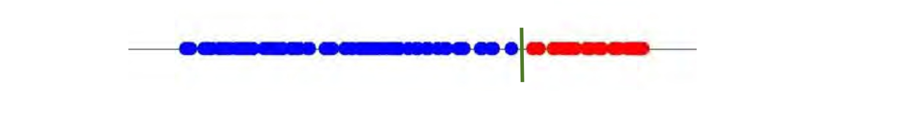
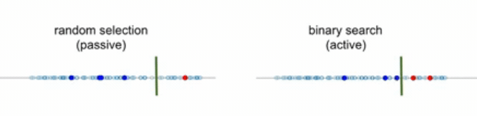
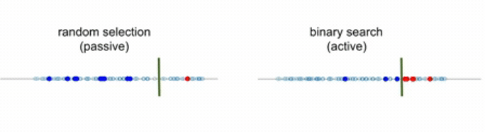
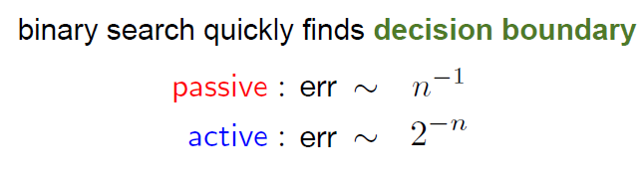
Learning a 1-D Classifier
Unlabeled data
Label them, then we can find a linear classifier
After a few sample the binary search the active procedure
has really nailed down where that decision boundary is.
Notes:
1. 例如血壓高於某個閥值，可能就有心臟病 (如紅點所示)
2. 比較passive learning : random sample, active learning : can be implemented as a binary search for bisection procedure where we keep trying to sample between the two closest oppositely labelled points
3. n 是 sample number, shows that with active method we got exponential speed-up in how quickly we can learn from a small set of labeled examples

Slide 15
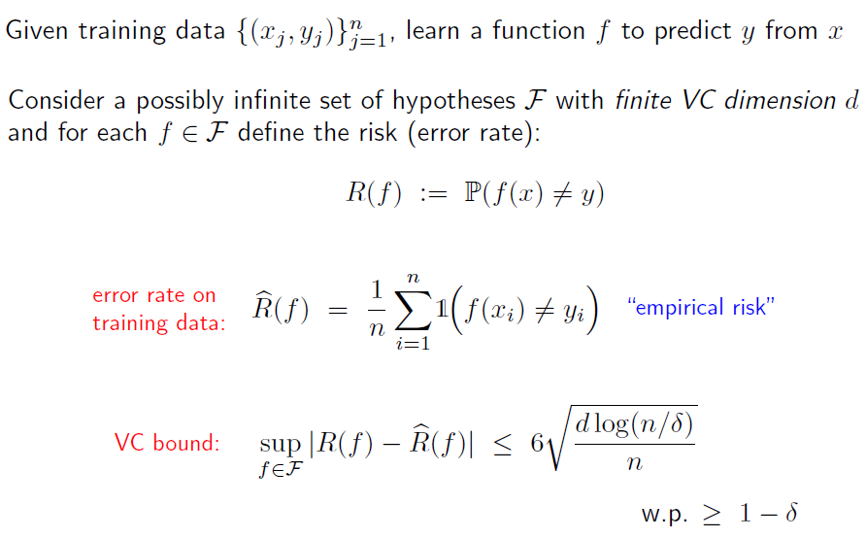
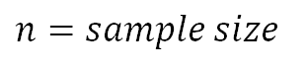
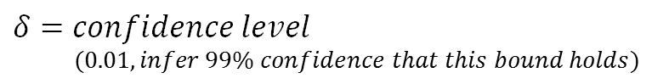
Vapnik-Chervonenkis (VC) Theory
true risk
with probability
$$n=sample size$$
$$δ=confidence level$$
$$(0.01, infer 99\% confidence that this bound holds)$$
Notes:
Generalize binary search to more complicated situations as VC theory.
Suppose we have a big pool of hypothesis or models and they have a finite VC dimension d (the dimension of feature space).
VC theory does for us is it allows us to bound uniformly over all the models in our class the deviation or difference between the true probability of error or true risk and the empirical risk of each and every classifier F.
So the bound is saying that the maximum absolute difference between R and R hat for any f is less than or equal to six times the square root of that VC dimension d.
VC dimension: the largest integer such that there exist the integer K so there exist K points that you can classify in all two to the K possible ways using classifiers

Slide 16
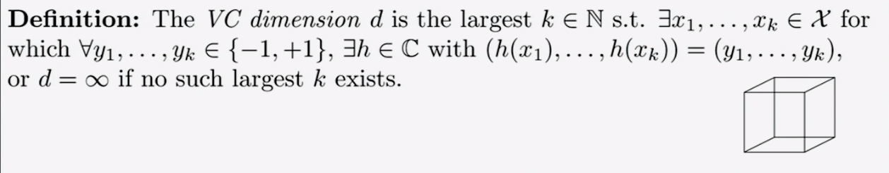
VC bound

Slide 17
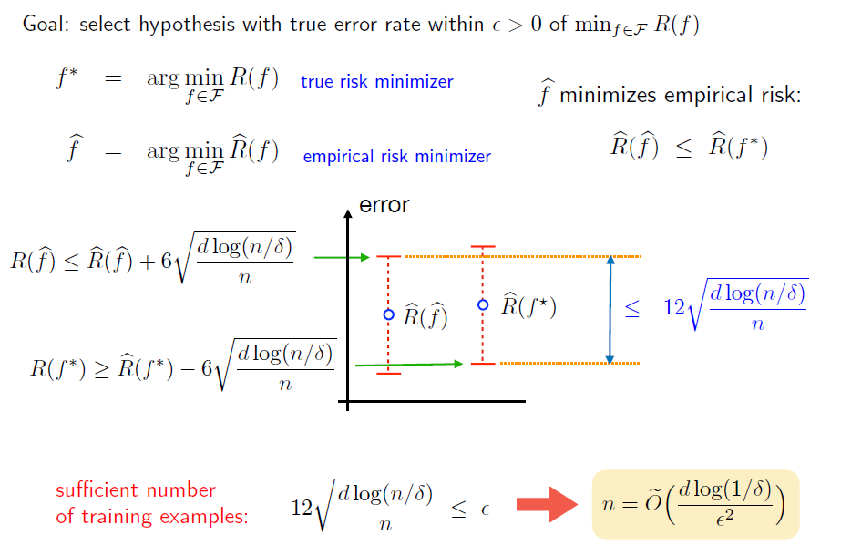
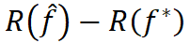
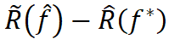
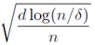

Empirical Risk Minimization (ERM)
$$R\left(\hat{f}\right)−R\left(f^{∗}\right)$$
- )
≦
+ 12
Notes:
The final equality saying that if you’re in a higher dimensional feature space or a larger vc class for higher vc dimension you’re going to need more training data.

Slide 18
Empirical Risks and Confidence Intervals
···
1 2 3 k-1 k
hypotheses (ordered according to empirical risks)

Slide 19
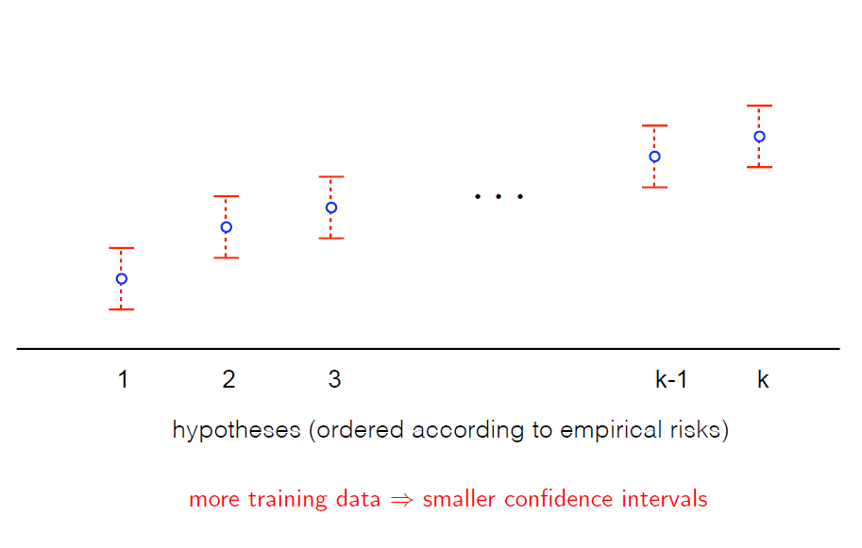
Empirical Risks and Confidence Intervals

Slide 20
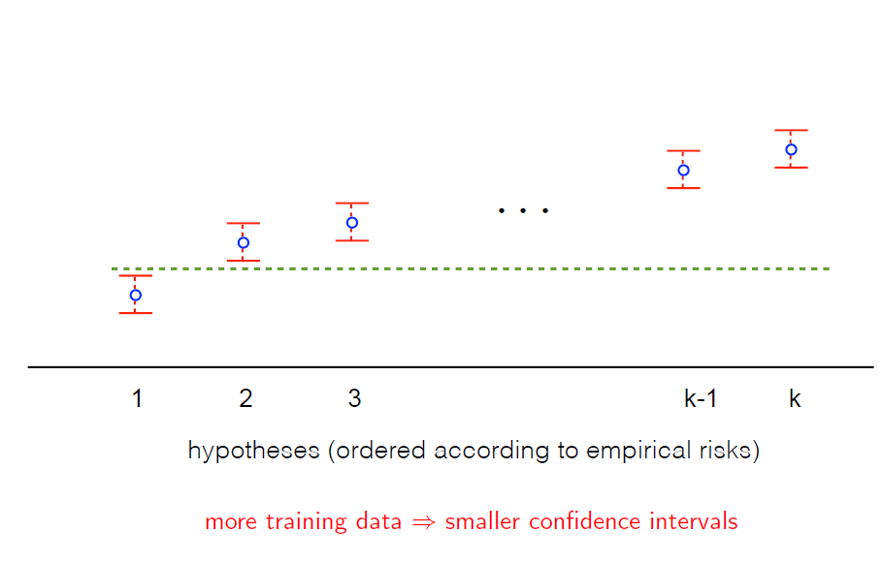
Empirical Risks and Confidence Intervals
Notes:
With the high confidence, model 1 is better than all the other models and that’s the idea of empirical risk minimization you can keep going until get the epsilon good model or looking for a the ones that cearly better than all within your finite set of models as the figure shown below (model 1).

Slide 21
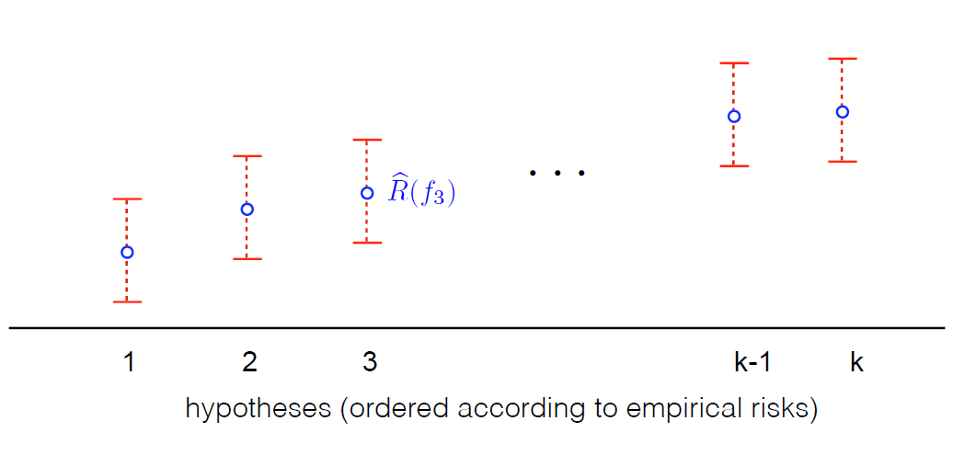
ERM is Wasting Labeled Examples
Notes:
the issue now is that the empirical risk minimization may wasting labeled examples.

Slide 22
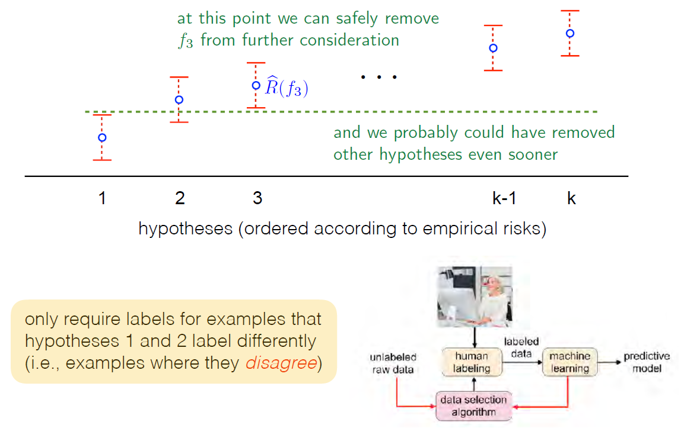
ERM is Wasting Labeled Examples
Notes:
“disagreement based learning”
Rather than continually asking for random examples at this point we’re going to kind of strategically select samples we’re going to only requires labels for examples where hypotheses or models 1 and 2 label and example differently where they disagree so this is the idea of disagreement based active learning.

Slide 23
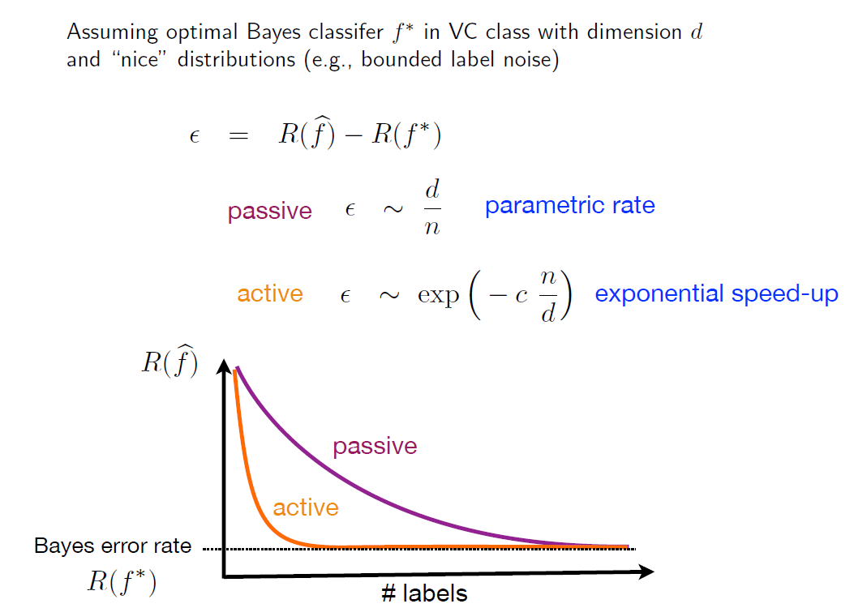
Active Binary Classification

Slide 24
Settles, Burr. "Active learning." Synthesis Lectures on Artificial Intelligence and Machine Learning 6.1 (2012): 1-114.
Dasgupta, Sanjoy. "Two faces of active learning." Theoretical computer science 412.19 (2011): 1767-1781.
Cohn, David, Les Atlas, and Richard Ladner. "Improving generalization with active learning." Machine learning 15.2 (1994): 201-221.
Castro, Rui M., and Robert D. Nowak. "Minimax bounds for active learning." IEEE Transactions on Information Theory 54, no. 5 (2008): 2339-2353.
Zhu, Xiaojin, John Lafferty, and Zoubin Ghahramani. "Combining active learning and semi-supervised learning using gaussian fields and harmonic functions." ICML 2003 workshop. Vol. 3. 2003.
Dasgupta, Sanjoy, Daniel J. Hsu, and Claire Monteleoni. "A general agnostic active learning algorithm." Advances in neural information processing systems. 2008.
Balcan, Maria-Florina, Alina Beygelzimer, and John Langford. "Agnostic active learning." Journal of Computer and System Sciences 75.1 (2009): 78-89.
Nowak, Robert D. "The geometry of generalized binary search." IEEE Transactions on Information Theory 57, no. 12 (2011): 7893-7906.
Hanneke, Steve. "Theory of active learning." Foundations and Trends in Machine Learning 7, no. 2-3 (2014).
Recommended Reading (Foundations of Active Learning)

Slide 25
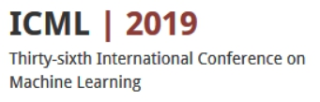
Part 2: Theory of Active Learning
General Case
Tutorial on Active Learning:
Theory to Practice
Steve Hanneke
Toyota Technological Institute at Chicago steve.hanneke@gmail.com
Robert Nowak
University of Wisconsin - Madison rdnowak@wisc.edu
• Disagreement-Based Agnostic Active Learning
• Disagreement Coefficient
• Sample Complexity Bounds
00:41:13~01:10:29

Slide 26
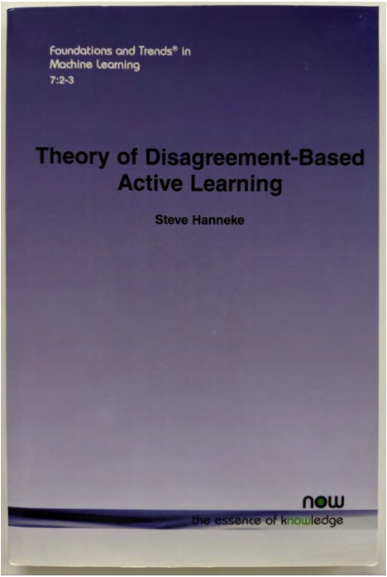
Agnostic Active Learning

Slide 27
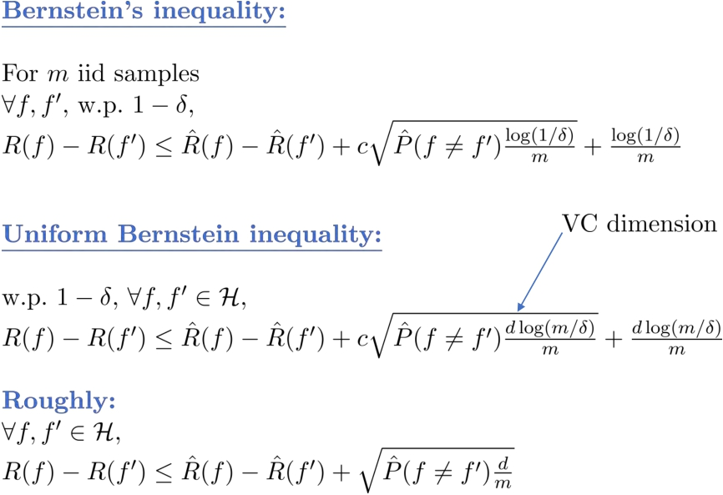
Uniform Bernstein Inequality
Just like the hoeffding bound
Notes:
前面介紹了 Hoeffding’s Inequality (取樣出來的結果會很接近真實情況)。In disagreement based active learning, need something tighter than Hoeffding’s Inequality is what’s we called Bernstein’s inequality. So if you have any two classifiers the difference of their risk is bounded by the difference of their empirical risk plus a term looks like the hoeffding bound .
m = the data on which the two classifiers disagree with each other

Slide 28
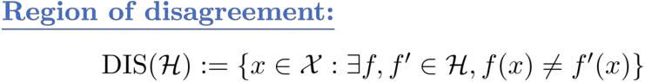
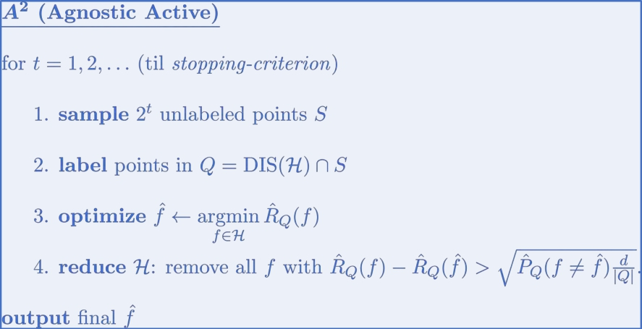
Agnostic Active Learning Balcan, Beygelzimer, & Langford (2006)
The set of points such that there exists two classifiers in H that disagree on the label of that point

Slide 29
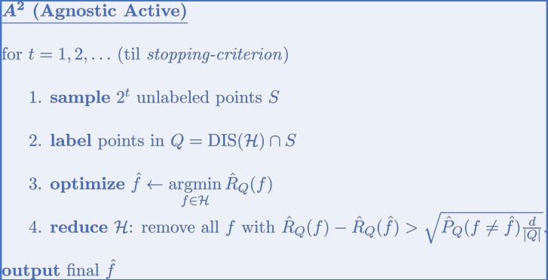
Agnostic Active Learning

Slide 30
Agnostic Active Learning
Notes:
把落在 disagreement region 中的 point 標上 label，而初始時，所有的點都會落在 disagreement region。
我們可以從H中找到一些classifier，去minimize現在given這些point的分類錯誤

Slide 31
Agnostic Active Learning

Slide 32
Agnostic Active Learning

Slide 33
Agnostic Active Learning

Slide 34
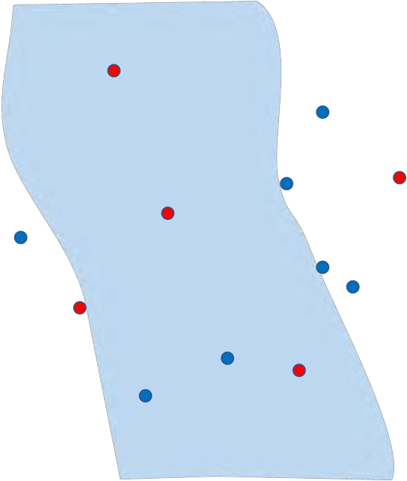

Agnostic Active Learning
Notes:
Pruned the set H down to a smaller set of candidate hypotheses and the region of disagreement of that set is potentially smaller and then we iterate. 抽取更多unlabeled sample，並只保留落在disagreement region的sample → 概念像是，因為disagreement region會越來越小，所以需要更大量的sample(2的t次方)才有可能sample到落在disagreement region上的unlabeled sample。

Slide 35

Agnostic Active Learning

Slide 36

Agnostic Active Learning

Slide 37

Agnostic Active Learning

Slide 38
Agnostic Active Learning

Slide 39
Agnostic Active Learning

Slide 40
Agnostic Active Learning

Slide 41


Agnostic Active Learning

Slide 42


Agnostic Active Learning
This difference is at most 0
Notes:
You never remove the best classifier from the hypothesis class.
If f* is in there at the beginning of the round then given that Bernstein’s inequality holds it’s still going to be there at the end of the round.
So this algorithm is sort of preserving this invariant that you never remove the best classifier from the hypothesis.

Slide 43
Agnostic Active Learning
Notes:
We can ask well then how many labels does it use in order to get a guarantee on the excess error rate.

Slide 44


Sample Complexity Analysis Hanneke (2007,…)
https://pdfs.semanticscholar.org/0626/241872b8def3e517e3af8acd12c5107c8c1a.pdf
Notes:
Using a concept called the disagreement coefficient for analyzing the label complexity. The label complexity is the number of data points for which we query for their labels.
L1 ball ?? The ball centered at f* of radius r is just a set of classifiers in H such that the probability that they disagree with that f* at the random point in the most r
Supremum 上確界
除以r：當ball的半徑越大，H裡的function f 就越多，DIS(・)就越大，相對Px(・)也會越大，為了消除r的影響所以除以r。

Slide 45


Sample Complexity Analysis

Slide 46


Sample Complexity Analysis

Slide 47


Sample Complexity Analysis

Slide 48

Sample Complexity Analysis
f*
Notes:
f* would be some separator like the red plane.

Slide 49

Sample Complexity Analysis
f ∈ B(f*,r) f*
Notes:
Other separator in the ball of radius r would be sort of just like f* except tilted a little bit just a slightly different angle

Slide 50

Sample Complexity Analysis
f*
DIS(B(f*,r))

Slide 51


Sample Complexity Analysis
f*
DIS(B(f*,r))
Notes:
A sphere in n dimension

Slide 52
Sample Complexity Analysis Hanneke (2007,…)
https://pdfs.semanticscholar.org/0626/241872b8def3e517e3af8acd12c5107c8c1a.pdf
Notes:
Using a concept called the disagreement coefficient for analyzing the label complexity. The label complexity is the number of data points for which we query for their labels.
L1 ball ?? The ball centered at f* of radius r is just a set of classifiers in H such that the probability that they disagree with that f* at the random point in the most r
Supremum 上確界
除以r：當ball的半徑越大，H裡的function f 就越多，DIS(・)就越大，相對Px(・)也會越大，為了消除r的影響所以除以r。
Theta denotes the probability that we get a data point in the disagreement region of the optimal hypothesis to label.

Slide 53





Sample Complexity Analysis
Notes:
An assumption on the type of noise that we’re dealing with we’ll look at two different assumptions.
Excess error n labels is a rate of convergence in terms of the number of labels

Slide 54

Sample Complexity Analysis
Notes:
|Q| become 2^t: 講者說如果我們把其他不在DIS(H)裡的東西倒進去，對於結果是沒有影響的（因為所有function都同意），到進去之後，我需要label的x就從Q個變成2^t個

Slide 55

Sample Complexity Analysis
Notes:
|Q| become 2^t: 講者說如果我們把其他不在DIS(H)裡的東西倒進去，對於結果是沒有影響的（因為所有function都同意），倒進去之後，我需要label的x就從Q個變成2^t個
Bound noise = 估計epsilon的範圍？
Bounded noise的condition imply the distance between the two classifiers that show up indise that square root its' bounded by a quantity propotional to the excess risk

Slide 56





Sample Complexity Analysis
Notes:
Bounded noise actually made some assumption on how the probability of y given x behaves. we can also just look at the general case we have arbitrary distribution on x and y, it’s called agnostic case.

Slide 57

Sample Complexity Analysis
Notes:
SKIP…………………………

Slide 58

Sample Complexity Analysis
Notes:
SKIP…………………………

Slide 59

Sample Complexity Analysis
Notes:
p.64中指出當theta小且beta小時，active learning speed-up，所以有些在研究theta甚麼時候會小。

Slide 60




Sample Complexity Analysis
Notes:
p.64中指出當theta小且beta小時，active learning speed-up，所以有些在研究theta甚麼時候會小。

Slide 61

Stopping Criterion
Notes:
Run out of unlabeled data : if you have a bounded amount of unlabeled data of course you can just run until you run out of unlabeled data
Disagreement active learning algorithms have this property of being self verifying and what that means is if you have an epsilon that you’re trying to achieve and so you know what excess error rate you’re aiming for you could evaluate this Bernstein inequality bound after each round it will tell you whether you’ve gotten there yet or not you can check whether you’re guaranteed excess error rate is at most epsilon after each round to set stopping criterion.

Slide 62


Simpler Agnostic Active Learning Hsu (2010,…)
http://www.cs.columbia.edu/~djhsu/papers/dissertation.pdf
Notes:
Empirical risk minimization can be challenging to run in practice. But you could just maybe plug in a different passive learning algorithm.

Slide 63



Surrogate Loss Hanneke & Yang (2012)
https://arxiv.org/pdf/1207.3772.pdf
Notes:
Consider a passive learning algorithm that minimizes we call a surrogate loss just a relaxation of the zero-one loss. So now you have some function class that has real valued functions and then basically you can minimize this surrogate loss function.

Slide 64

Surrogate Loss

Slide 65


Importance-Weighted Active Learning
Beygelzimer, Dasgupta, Langford (2009)
https://arxiv.org/pdf/0812.4952.pdf
Notes:
There is one other variant. We can also talk about strategies that set a probability of querying and this gets into this importance weighted active learning idea. On each round you get x and not let’s set a probability and say p_{x} that you query that point then you flip a coin with that probability as its bias if it lands heads you query if lands tails you don’t but if you do query the label add it to the dataset but edit with a weight 1/p_{x} . The reason you do that is because the weighted empirical risk with those weights on the loss ends up being an unbiased estimator of the actual risk

Slide 66

Importance-Weighted Active Learning
Beygelzimer, Dasgupta, Langford (2009)
Notes:
uses importance weighting to correct sampling bias

Slide 67

Questions?

Slide 68
Part 3: Beyond Disagreement-Based Active Learning – Current Directions
Tutorial on Active Learning: Theory to Practice
Steve Hanneke
Toyota Technological Institute at Chicago steve.hanneke@gmail.com
Robert Nowak
University of Wisconsin - Madison rdnowak@wisc.edu
• Subregion-Based Active Learning
• Margin-Based Active Learning: Linear Separators
• Distribution-Free Analysis, Optimality
• TicToc: Adapting to Heterogeneous Noise
Notes:
Following section is going to introduce different various ways that people have proposed get a little bit better than disagreement based active learning.

Slide 69

Subregion-Based Active Learning
Notes:
這一篇有一連串的work如Margin-based active learning。
在這個sub region外，兩個classifier互相不同意的機率很低（小於epsilon）

Slide 70


Subregion-Based Active Learning
https://arxiv.org/pdf/1407.2657.pdf
Notes:
Instead of taking the whole region of disagreement let’s take the sub region (smaller set) that has some guarantee that for any two classifier and that are left in the hypothesis class the probability that they disagree on a point that’s outside of that region is at most some epsilon prime.
如果把R(H)當成disagreement region，那就和A square一樣

Slide 71



Subregion-Based Active Learning
Notes:
Quantify the sample complexity of this algorithm. We replace the disagreement coefficient with new quantity(sub region).
Phi = previous theta but in sub-region

Slide 72

Subregion-Based Active Learning
Notes:
Beta : the error rate of the best classifier
Because this subregion is potentially smaller than the region of disagreement these complexity measure is can be smaller than the disagreement coefficient.
Beta 不是設定好的，所以會出現在phi裡

Slide 73



Subregion-Based Active Learning
Notes:
Empirically : set up linear program approach to use the dataset to figure out whether the point should be include in the region or not.
Nixe structure : using some nice structure in the hypothesis class and distribution.
Ex. Linear seperator -> Margin-based active learning 的概念

Slide 74

Subregion-Based Active Learning
Notes:
Sub-region is from some separators

Slide 75


Subregion-Based Active Learning

Slide 76



Subregion-Based Active Learning

Slide 77

Subregion-Based Active Learning

Slide 78

Subregion-Based Active Learning

Slide 79




Subregion-Based Active Learning

Slide 80

Subregion-Based Active Learning

Slide 81

Subregion-Based Active Learning

Slide 82

Margin-Based Active Learning
http://tongzhang-ml.org/papers/colt07-active.pdf

Slide 83
Margin-Based Active Learning

Slide 84

Margin-Based Active Learning

Slide 85

Margin-Based Active Learning

Slide 86

Margin-Based Active Learning

Slide 87

Margin-Based Active Learning

Slide 88


Computational Efficiency
https://arxiv.org/pdf/1503.03594.pdf
Notes:
Hinge loss 在每一round都會增加slope

Slide 89

Computational Efficiency
Notes:
Hinge loss 每一round都會增加

Slide 90


Computational Efficiency

Slide 91
Up Next:
Distribution-free Analysis

Slide 92

Distribution-Free Analysis
h3
x3
h2
h4
x4
x2
h1 x1 h0 x5 h5
x8 x7 x6
h8 h6
h7
https://arxiv.org/pdf/1410.0996.pdf
Notes:
The above algorithms are distribution dependent quantification. We can do a sample complexity analysis without a distribution dependent.
固定一個classifier h0，有幾個不重疊的part（一邊是h0另一邊是hi）能夠成為disagreement region

Slide 93

Distribution-Free Analysis
h3
x3
h2
h4
x4
x2
h0 x7
h7
x5 x6
h1
h5
x1
x2
x1
x8
h1
h0
h2
h8
h6

Slide 94

Distribution-Free Analysis
h3
x3
h2
h4
x4
h2
x2
x1 x2 h3 h1 x1 h0 x5 h5
h1
h0
x6
x3
h5
x8
x7
h7
h4
x4
h8
h6
x6
x5
h6

Slide 95

Distribution-Free Analysis
h3
x3
h2
h4
x4
x2
…
x1 x2 x3 x4 x5 h1 x1 h0 x5 h5
x8 x7 x6
h0 h1 h2 h3 h4 h5 h8 h6
h7

Slide 96


Distribution-Free Analysis
h3
x3
h2
h4
x4
x2
h1 x1 h0 x5 h5
x8 x7 x6
h8 h6
h7
Notes:
What we are previously doing is to find the minimum of s and 1/epsilon
固定h0作為DIS{H}的一邊界，

Slide 97

Distribution-Free Analysis
h3
x3
h2
h4
x4
x2
h1 x1 h0 x5 h5
x8 x7 x6
h8 h6
h7
Notes:
我們推論是這樣，但實際上有演算法能使結果更好（已經接近下限）

Slide 98


Distribution-Free Analysis
Notes:
但是在agnostic的時候，這就是optimal了嗎？沒有人知道

Slide 99

Adapting to Heterogeneous Noise
So far: Active learning for spatial heterogeneity of opt function:
-
Also consider: Spatial heterogeneity of noise:
1
0
-1
+ | - |  |  |  |  |  | +
-
 | + |  |  |  |  | -
 | + |  |  |  | -
 |  |  |  |  |  | +
 | + |  |  | -
 |  | - | +
 | +
Notes:
Disagreement base 無法解決上圖的問題
Adpating to heterogeneity in the noise meaning that there's some places that are very noisy and some places that are less noisy and you might want to adjust how many queries you make in each of those types of regions.

Slide 100

Active Learning with TicToc
Notes:
https://simons.berkeley.edu/talks/steve-hanneke-02-17-2017
If you have noise, you can’t trust that it is the optimal label, so you have to modify the algorithm or it will do some crazy thing with noise
https://youtu.be/cutF-1e_LLY?t=2467

Slide 101



Active Learning with TicToc

Slide 102

Active Learning with TicToc

Slide 103

Active Learning with TicToc
Notes:
The original assumption and the extra assumption are the same?

Slide 104

Principles of Active Learning

Slide 105

Conclusions

Slide 106

Questions?

